Slide 1
8085 Assembly Language

Slide 2
Experiment
To learn assembly language program and understand the concept of different types of byte instruction execution in 8085 architecture.
General requirements :
Software requirements: GNU Sim 8085
Operating System: Windows 7
Hardware requirements: P-IV C2D 2.9 GHZ
320 GB HDD/2 GB RAM

Slide 3
Assembly language is a low-level programming language used to interface with computer hardware.
Assembly language uses structured commands as substitutions for numbers allowing humans to read the code easier than looking at binary.

Slide 4
Format of the instruction in assembly language is :-
Label | Operation | Operands
Its optional | Necessary | Necessary

Slide 5
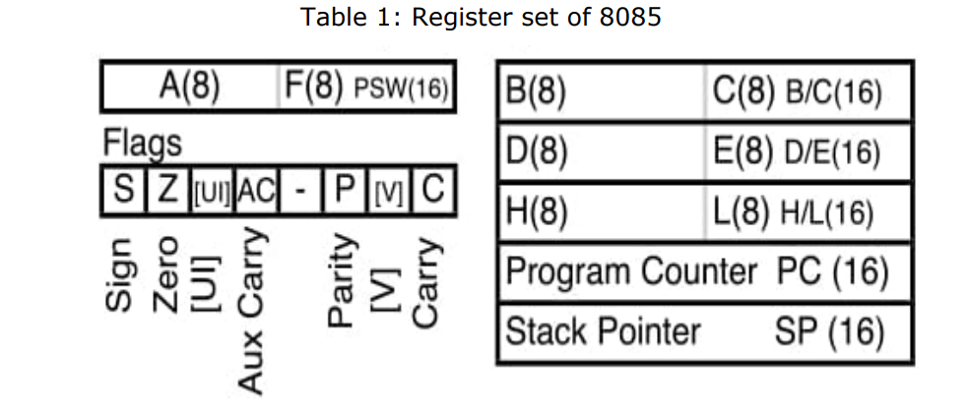

Slide 6
Registers
1. Accumulator (A) is an 8-bit register which is used to perform arithmetical and logical operation. It stores the output of any operation. It also works as registers for I/O accesses.
2. General Purposes Registers are of 8-bit each named as B, C, D, E, H and L. Generally, these registers are not used for storing the data permanently. These are used only during the execution of the instructions. These registers can also be used to carry the 16 bits data by making the pair of 2 registers. The valid register pairs available are BC, DE HL. We cannot use other pairs except BC, DE and HL.

Slide 7
3. Flag Registers consist of 5 flip-flops which changes its status according to the result stored in an accumulator. It is also known as status registers. It is connected to the ALU.
There are five flip-flops in the flag register are as follows:
Sign: If D7 of the result is 1 then sign flag is set otherwise reset. As we know that a number on the D7 always decides the sign of the number. If D7 is 1: the number is negative. If D7 is 0: the number is positive.
Zeros (Z): If the result stored in an accumulator is zero then this is set otherwise it is reset.
Auxiliary carry (AC): If any carry goes from D3 to D4 in the output then it is set otherwise it is reset.
Parity (P): If the no of 1's is even in the output stored in the accumulator then it is set otherwise it is reset for the odd.
Carry(C): If the result stored in an accumulator generates a carry in its final output then it is set otherwise it is reset.

Slide 8
4. Program Counter is a 16 bit register used as memory pointer. It stores the memory address of the next instruction to be executed. So we can say that this register is used to sequencing the program. Generally the memory has 16 bit addresses so that it has 16 bit memory. The program counter is set to 0000H.
5. Stack Pointer is also a 16 bit register used as memory pointer. It points to the memory location called stack. Generally stack is a reserved portion of memory where information can be stores or taken back together.

Slide 9
Instructions
Data Transfer Group: Instructions which are used to transfer the data from a register to another register from memory to register or register to memory come under this group
Arithmetic Group: The instructions of this group perform arithmetic operations such as addition, subtraction, increment or decrement of the content of a register or a memory.
Logical Group: The instructions in this group perform logical operation such as AND, OR, compare, rotate, etc
Branch Control Group: group contains the instructions for conditional and unconditional jump, subroutine call and return, and restart.
Stack, I/O and Machine Control Group: This group contains the instructions for input/output ports, stack and machine control.

Slide 10
Data transfer instructions
Instruction | Explanation | Machine Cycles | Example
MOV r₁, r₂ [r1] ← [r2] | Move the content of the one register to another | 1 | MOV A, B
MOV r, M [r]←[[H-L]] | Move the content of memory to register | 2 | MOV B, M
MOV M, r [[H-L]]←[r] | Move the content of register to memory | 2 | MOV M, C
MVI r, data [r] ←data | Move immediate data to register | 3 | MVI M, 08
LXI rp, data 16 [rp] ←data 16 bits, [rh] ←8 MSBs, [rl] ←8 LSBs of data | Load Register pair immediate | 3 | LXI H, 2500
LDA addr [A] ←[addr] | Load Accumulator direct | 4 | LDA 2400
STA Addr [addr] ←[A] | Store accumulator direct | 4 | STA 2000

Slide 11
Arithmetic group
ADD r [A] ←[A]+[r] | Add register to accumulator | Register | 1 | ADD K
ADD M [A] ← [A] + [[H-L]] | Add memory to accumulator | Register indirect | 2 | ADD M
SUB r [A] ←[A]-[r] | Subtract register from accumulator | Register | 1 | SUB K
SUB M [A] ← [A] - [[H-L]] | Subtract memory from accumulator | Register indirect | 2 | SUB M

Slide 12
GNUSim8085 is a 8085 microprocessor simulator with following features.
A simple editor component with syntax highlighting.
A keypad to input assembly language instructions with appropriate arguments.
Easy view of register contents.
Easy view of flag contents.
Hexadecimal <--> Decimal converter.
View of stack, memory and I/O contents.
Support for breakpoints for programming debugging.
Stepwise program execution.
One click conversion of assembly program to opcode listing.

Slide 13
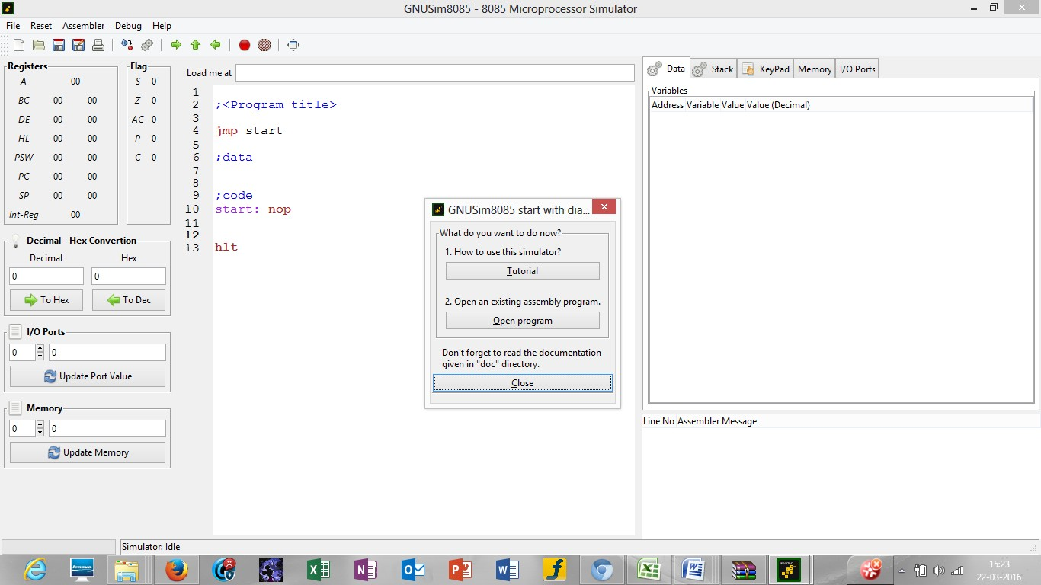
HOW TO START WITH GNU Simulator 8085
Step1: Open GNU Sim 8085 below window will open. Now click on close button highlighted in the screen shot.

Slide 14
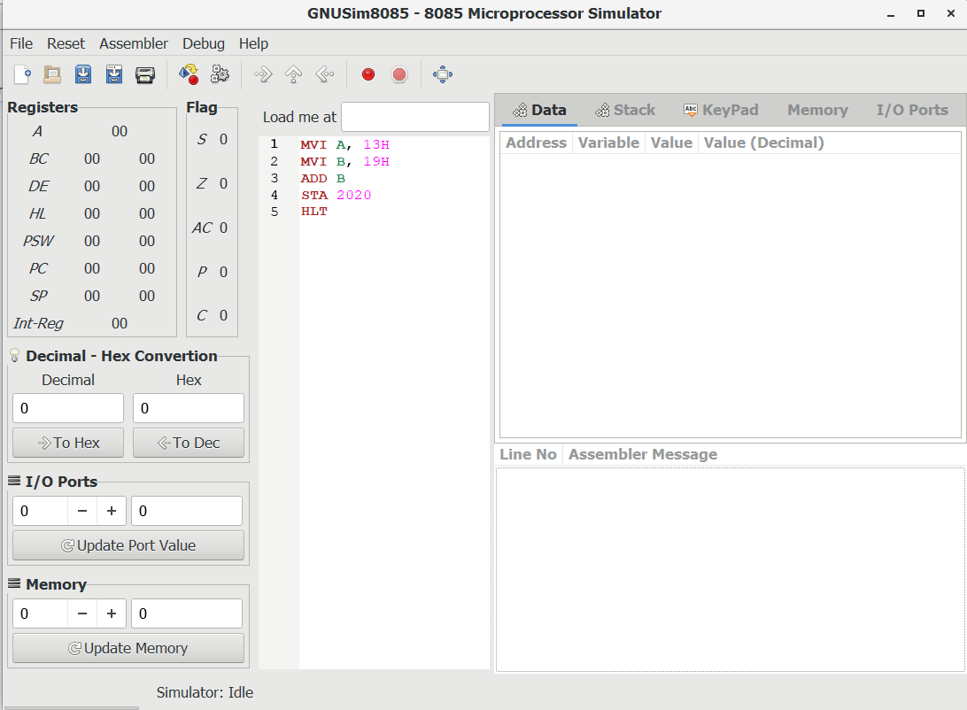
Step2: start writing the code where the last line of the code should be HLT and save it in a specified folder.

Slide 15
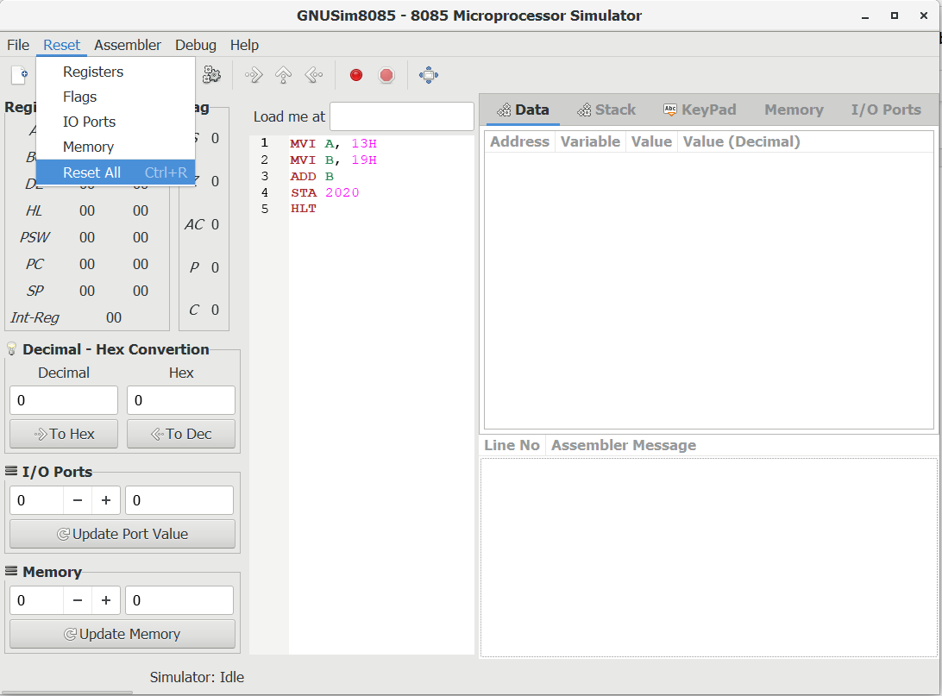
Step 3: click on reset and reset all the registers by clicking on reset all.

Slide 16
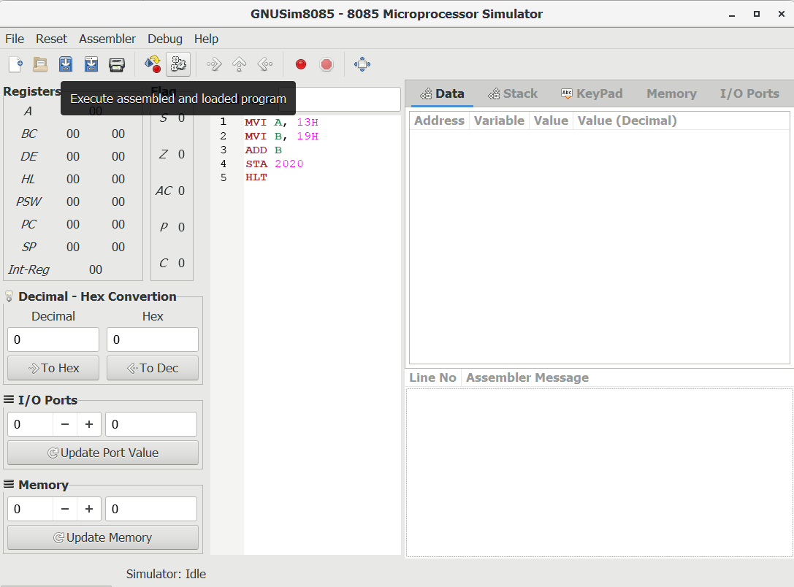
Step 4: click on the highlighted button to execute the code.

Slide 17
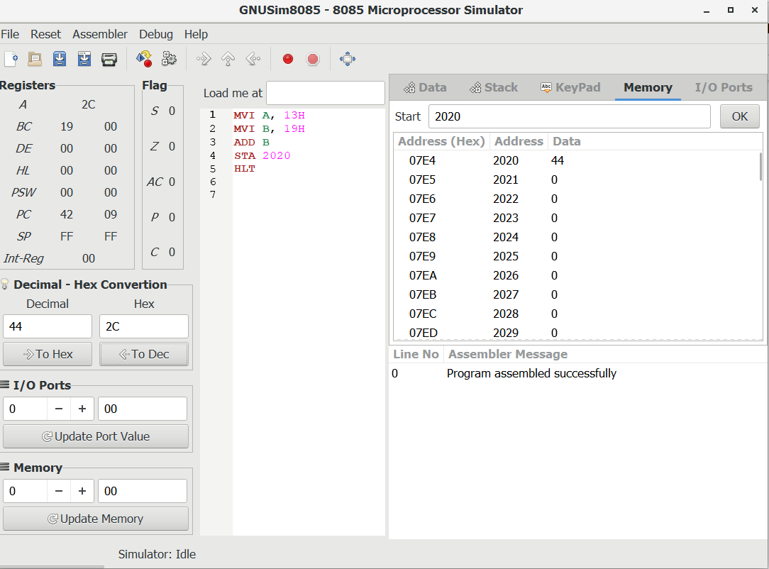
Step 5: after this you will see the result of the instructions in the respective registers and memory as seen in the above picture 5.

Slide 18
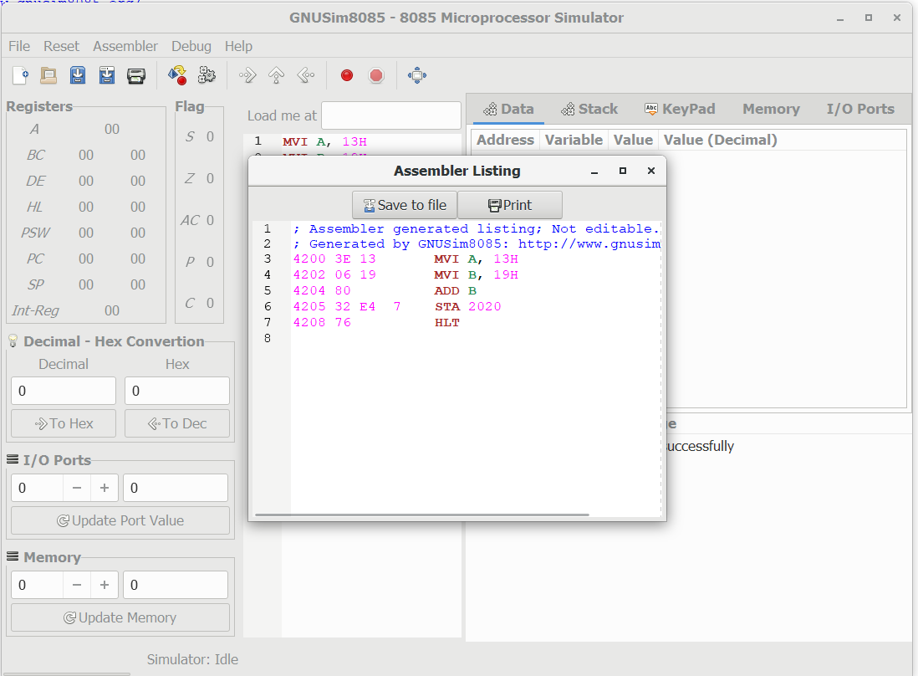
Step 6: Click on Show listing option to show the details of machine code along with memory locations as seen in picture 6.

Slide 19
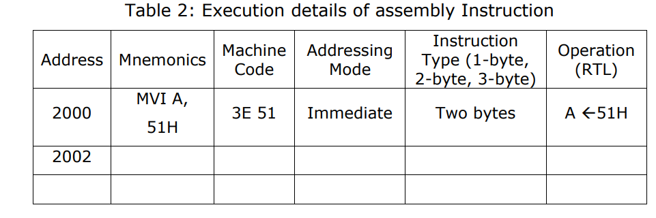
Click on Show listing option to show the details of machine code along with memory locations

Slide 20
1. An assembly program to add two numbers.
2. An assembly program to subtract two numbers.

